Slide 1


CPSC 462 – Software Design
Elaboration Phase Iteration 2
Presentation Chart Set Template
Professor T. L. Bettens
Fall 2018

Slide 2
Instructions
The slides contained in this template form the required outline for your final presentation. You are to populate each slide with you team’s unique information.
Look for and either replace or remove text in angle brackets <LIKE THIS>
Four 25-minute presentations in a day
Plan on a 20 minute presentation, I’ll cut you off at 22
Anticipate quick transitions between team’s presentations
be ready when it’s your time
You must upload your presentation and demo content prior to class on the day of your scheduled timeslot
I’ll have your uploaded files ready for you when you present

Slide 3
Instructions
Content is divided into Chart Sets. Each Chart Set covers a required topic
You may add additional charts to any Chart Set if there is not enough real estate on the slide to present your information cleanly and clearly
But be mindful of the time
You may not delete a Chart Set
Video clips should be 30 seconds or less
Rename this file to “E2 Design Walkthrough Chart Set - Team <your team number>”
For example: E2 Design Walkthrough Chart Set - Team 22.pptx

Slide 4
Instructions
When you embed pictures, you may resize to fit, …
… but you must allow for the full, high definition, readable picture to be viewed
If your presentation file is too big to deliver through TITANium, consider
more aggressive compression and resampling
Shorter video clips
If that still doesn’t work, then video clips may be delivered as separate files provided that
A picture place holder is present
A (preferably hot) link is provided

Slide 5
CPSC 462 – Software Design
CityBuilder
Elaboration Phase Iteration 2
Team 9
Final Project Critical Design Walkthrough and Demonstration
Professor T. L. Bettens
Fall 2018

Slide 6
Agenda
Topic | Slide Number | Estimated Duration
Chart Set 1 - Team Identification | Slide 7-8 | 1 min
Chart Set 2 - Project Description | Slide 9-12 | 1 min
Chart Set 3 - Requirements Analysis | Slide 13-19 | 5 min
Chart Set 4 - Logical View | Slide 20-30 | 5 min
Chart Set 5 - Design Model | Slide 31-39 | 7 min
Chart Set 6 - Documentation | Slide 40-45 | 1 min
total | 41 slides | 20 min

Slide 7
CHART SET 1 TEAM IDENTIFICATION

Slide 8
Chart Set 1 – Team Identification
Team # 9
Team Members:
Richard Echeverria, Patterns Lead and Use Case Master
Marcus Hoertz, Lead Designer and Code Master
Steven Te, Diagram Master and Lead Architect
Design Review Date: December 5th, 3:55-4:20

Slide 9
CHART SET 2 PROJECT DESCRIPTION

Slide 10
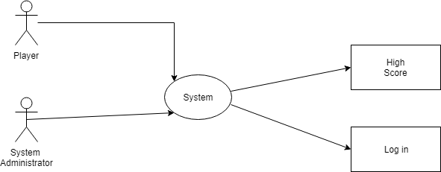
Chart Set 2 – Project Description Vision
This Project aims to create a fun experience for Three players to see themselves as city planners, creating various buildings to see who is the best City Builder.
Players take turns gathering and building until the eventual winner is found.
This is modeled after a popular board game, so it will bring in a large amount of users wanting to play.
Pictured above: Primary actors System Administrator and Player, system, and external systems High Score and Log in

Slide 11
Chart Set 2 – Project Description Stakeholders
Key Stakeholders
CEO (Mr. Bettens)
Final say on all aspects of the project and grading guidelines
Managers
Have to pay the developers to make the system
Users
Interact with the system, try to win the game

Slide 12
Chart Set 2 – Project Description Risks
Risk Summary
Risk Status
Project Completed on time
Initial Player Interest
Account Fraud
User fatigue
Inception Phase and Elaboration phase 1 have been passed, Elaboration phase 2 is nearing completion
Added variations for play, leaderboard for comparison, Added the option to quit
Validation of user must be done in presence of System Administrator, however have not had a way of maintaining validation
Players could log in for one another
Still many alternate options possible for the system, would still have to be tested and validated
more defined game rules and more player interaction would prove difficult

Slide 13
CHART SET 3 REQUIREMENTS ANALYSIS

Slide 14
Chart Set 3 – Requirements Analysis Non-Functional Requirement Summary
Functionality
System shall maintain a Data Backlog for persistence purposes
System shall have a user Login Feature with Validation
Quality Attributes
User(s) shall be age 18 or older
System shall have an average uptime and availability of 99%
System shall be executable in both windows and linux
Interfaces
User(s) shall interact through the use of a keyboard through the command line
Domain Rules
Player(s) shall take exactly one action on their turn
Winner shall be determined by the player with the most points at end of game

Slide 15
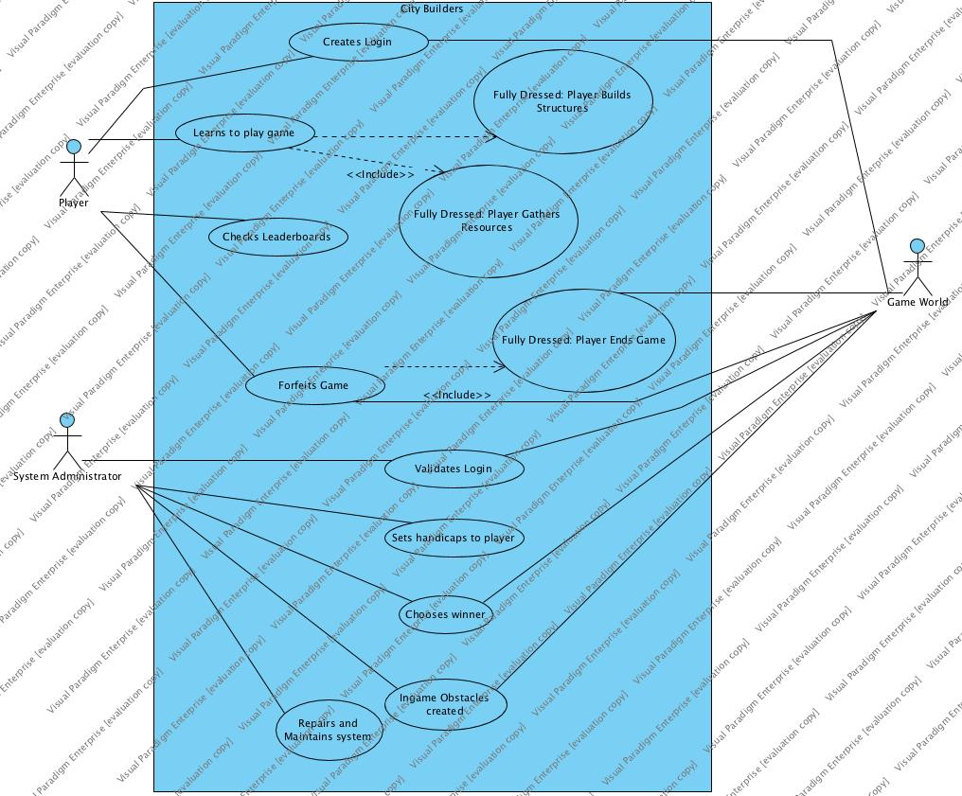
Chart Set 3 – Requirements Analysis Functional Requirements Summary
Login shall be validated and used
Player shall learn game rules and use them to play game
Player shall be able to see their leaderboard score
Administrator shall maintain a fair play environment
Administrator shall maintain system
All of our use cases (Including fully dressed) Shown above, with system administrator, player, and game world

Slide 16
Chart Set 3 – Requirements Analysis Fully Dressed Use Case- Player wins game
Primary Actor- Player
Precondition- Player has a user account
Main Success Scenario
Player logs in
Player Gathers resource
Player Builds Structure
Repeat step 2 and 3 until 5 buildings made
Player triggers end game
Player wins the game
System Closes
Post Conditions- leaderboard has been updated and system was terminated

Slide 17
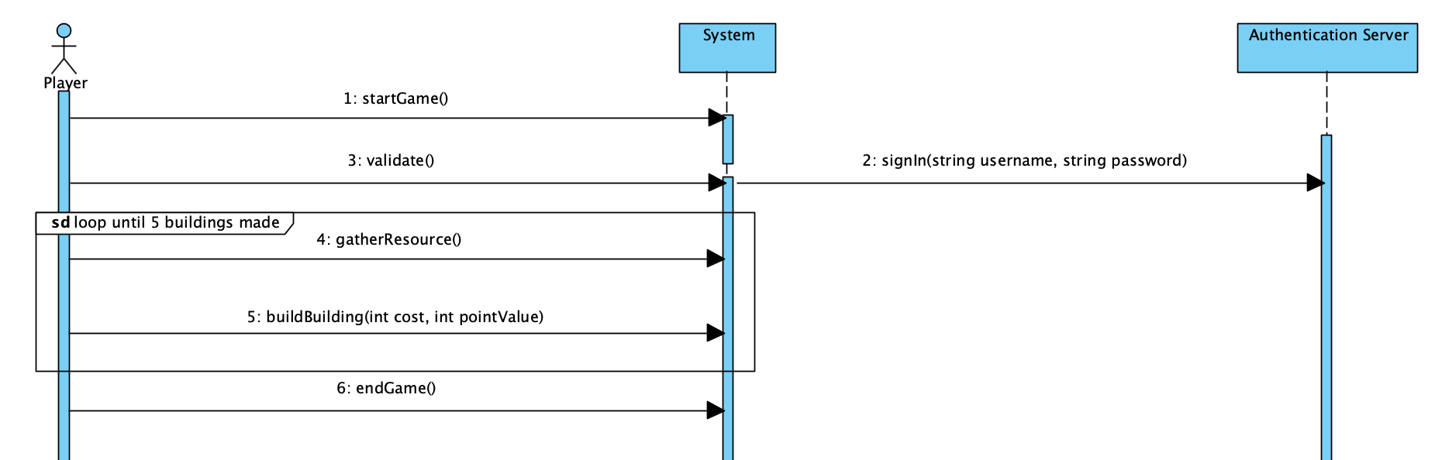

Chart Set 3 – Requirements Analysis Fully Dressed Use Case Sample 1
<SSD diagram here>
<SSD Demonstration Video Here>
System calls that are used in the player wins game
Video Showing Player wins game

Slide 18
Chart Set 3 – Requirements Analysis Fully Dressed Use Case- Player Forfeits turn
Primary Actor- Player
Precondition- Player has a user account
Main Success Scenario
Player Logs in
Player Takes a gather action
Player takes a build action
Player chooses the forfeit option on their turn
Post Conditions
System updated game to have one less player
System removed player from game and gave control to the next player

Slide 19
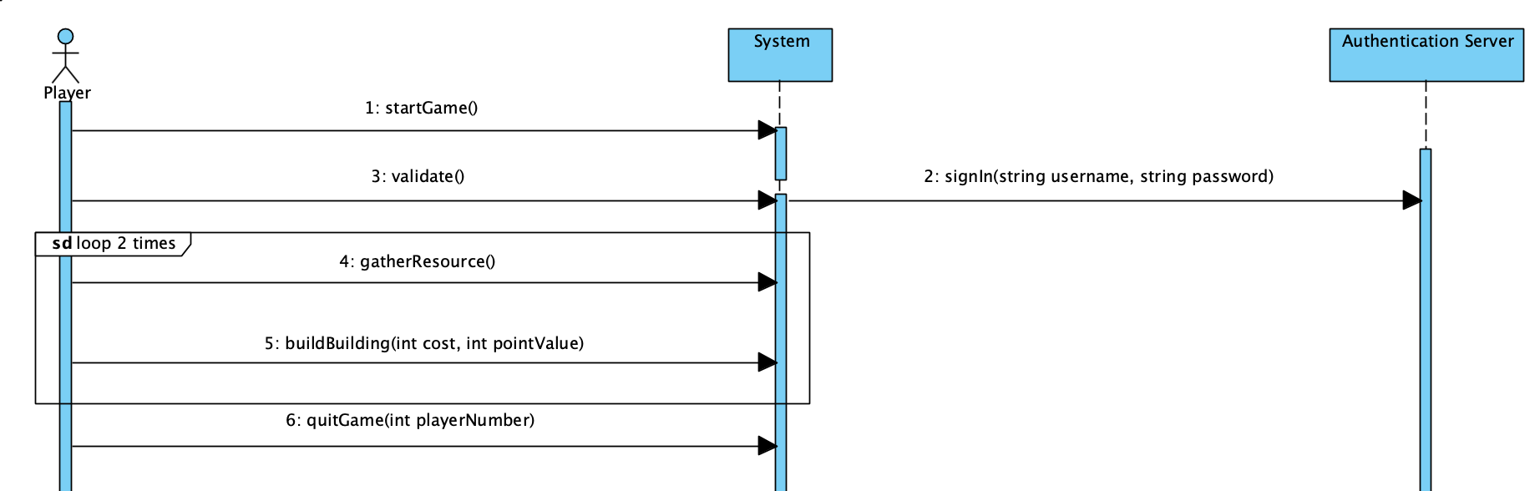
Chart Set 3 – Requirements Analysis Fully Dressed Use Case Sample 2
<SSD diagram here>
<SSD Demonstration Video Here>
Diagram showing the function calls for forfeit game use case
Video showing Player forfeits game

Slide 20
CHART SET 4 LOGICAL VIEW

Slide 21
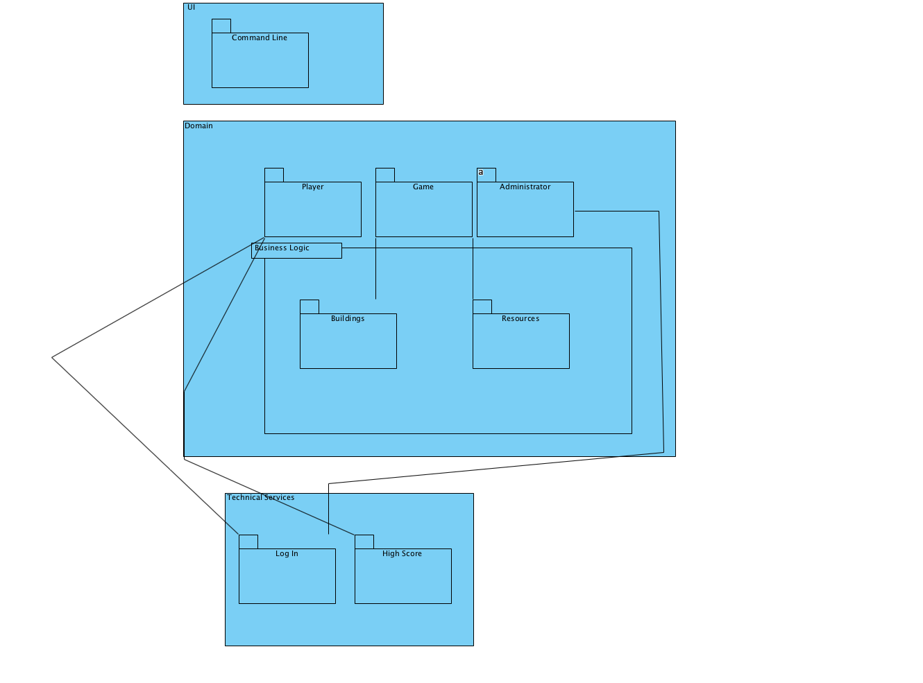
Chart Set 4 – Logical View Package & Component Structure
UI Layer
Domain (Application) Layer
Player - Representation of the user in the system
Game- holds the main game logic
Building - Holds the polymorphic building classes
Resources- Holds the resource descriptions
Administrator- handles our Administrator packages (currently not realized)
Technical Services Layer
Persistence - Holds our High score persistence instance
Logging - is a container for our login interface and it’s class instances
Package diagram with UI, Business, and Technical Service Layers

Slide 22
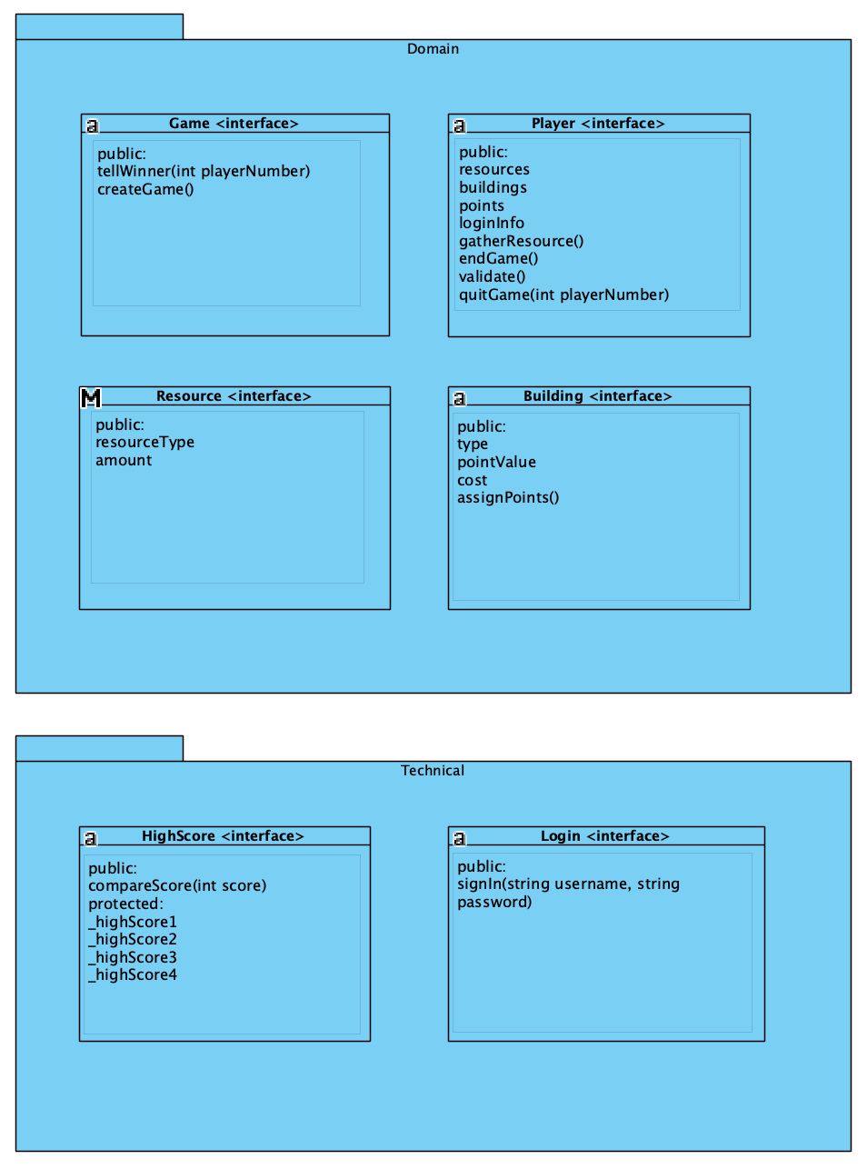
Chart Set 4 – Logical View Interfaces
Domain Layer Interfaces
Game- handles the game logic of the system, and player instances
Player- handles the player logic and player instances
Resource- handles how resources are generated in the game
Building- handles the building logic and how they are generated in the game
Technical Services Layer Interfaces
Login - handles how players are logged in and authenticated in the system
High Score - handles how the high score is processed in the system
Diagram of our Interfaces- Game, Player, Resource, Building, Login, and High Score

Slide 23
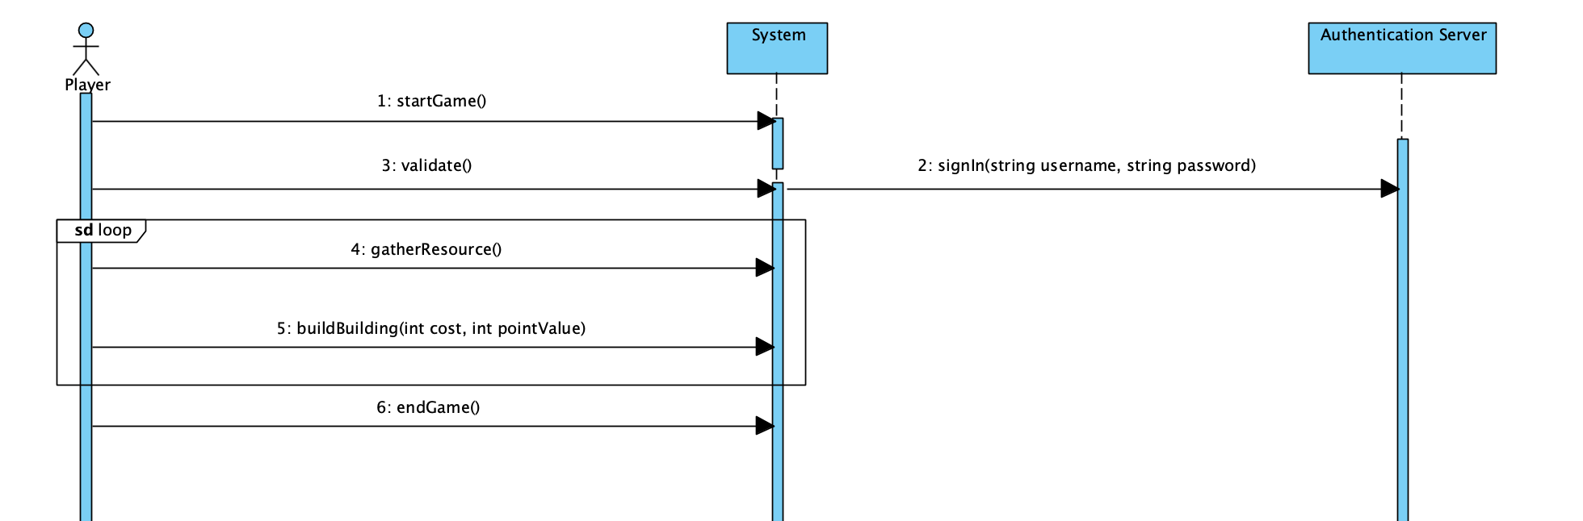
Chart Set 4 – Logical View SSD to Interface Mapping
<SSD diagram here>

Slide 24
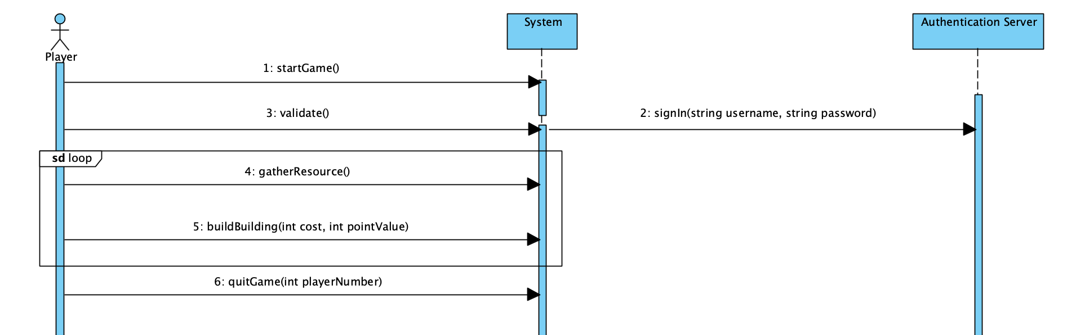
Chart Set 4 – Logical View SSD to Interface Mapping
<SSD diagram here>

Slide 25
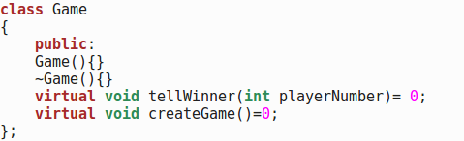
Chart Set 4 – Logical View Interface to Code Mapping
<Source Code here>

Slide 26
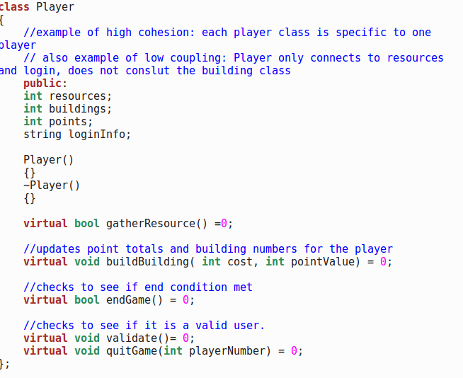
Chart Set 4 – Logical View Interface to Code Mapping
<Source Code here>

Slide 27
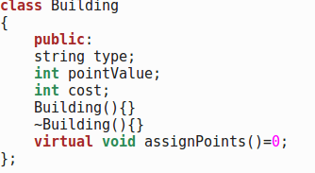
Chart Set 4 – Logical View Interface to Code Mapping

Slide 28
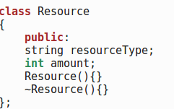
Chart Set 4 – Logical View Interface to Code Mapping

Slide 29
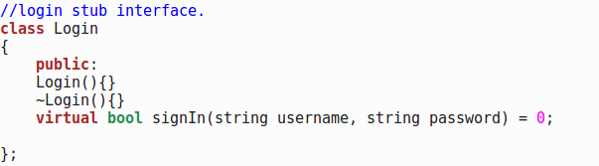
Chart Set 4 – Logical View Interface to Code Mapping

Slide 30
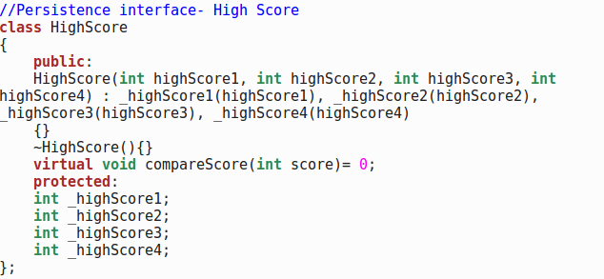
Chart Set 4 – Logical View Interface to Code Mapping
<Source Code here>

Slide 31
CHART SET 5 DESIGN MODEL

Slide 32
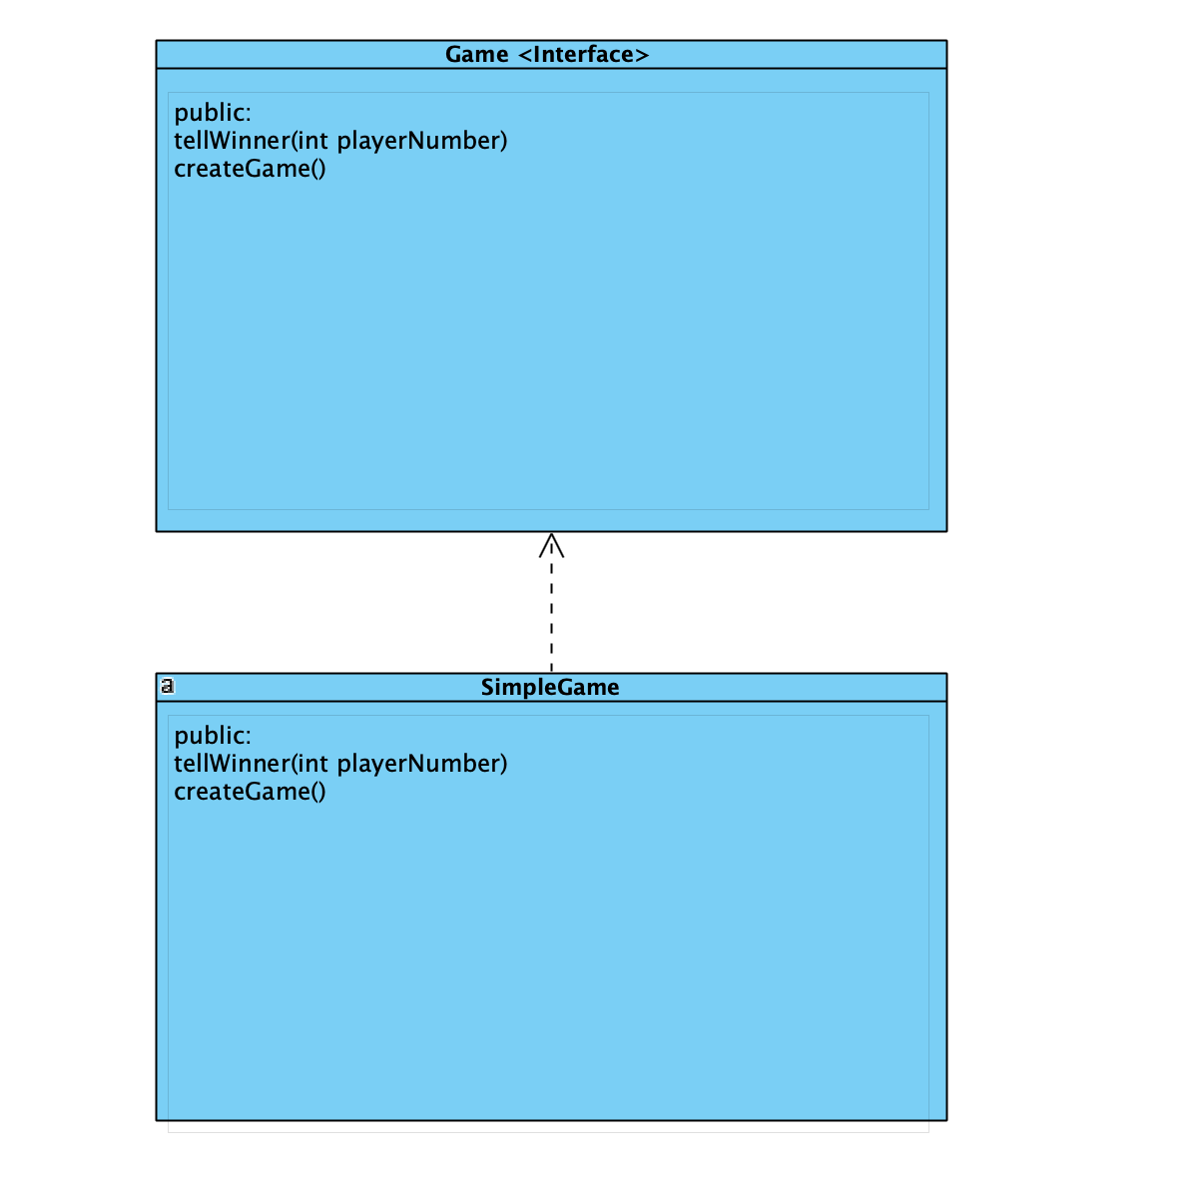
Chart Set 5 – Design Model Interface Realizations
Game interface- realized through the SimpleGame class
<Class Hierarchy diagram here>
Game interface and it’s realizations

Slide 33
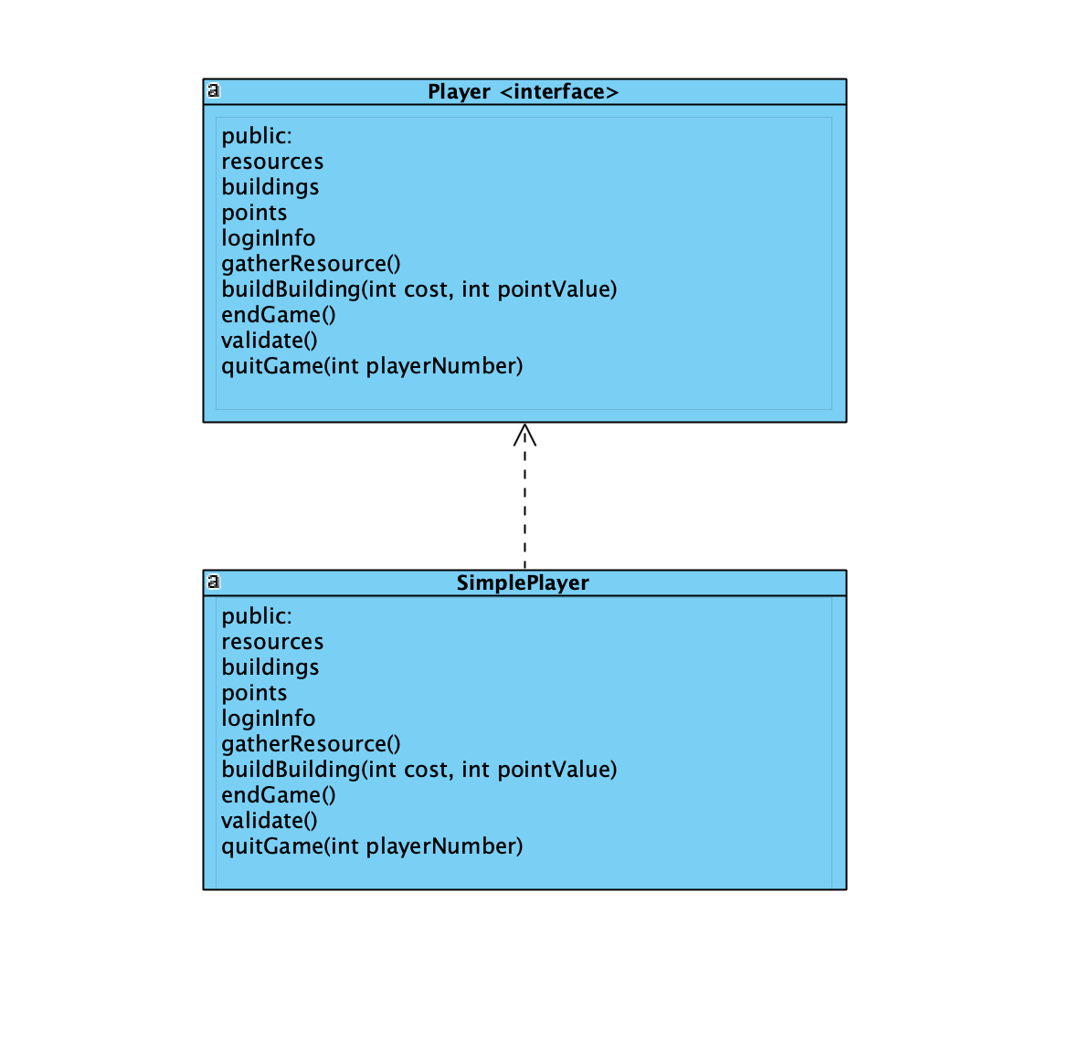
Chart Set 5 – Design Model Interface Realizations
Player Interface- realized through the SimplePlayer class
<Class Hierarchy diagram here>
Player Interface and it’s realizations

Slide 34
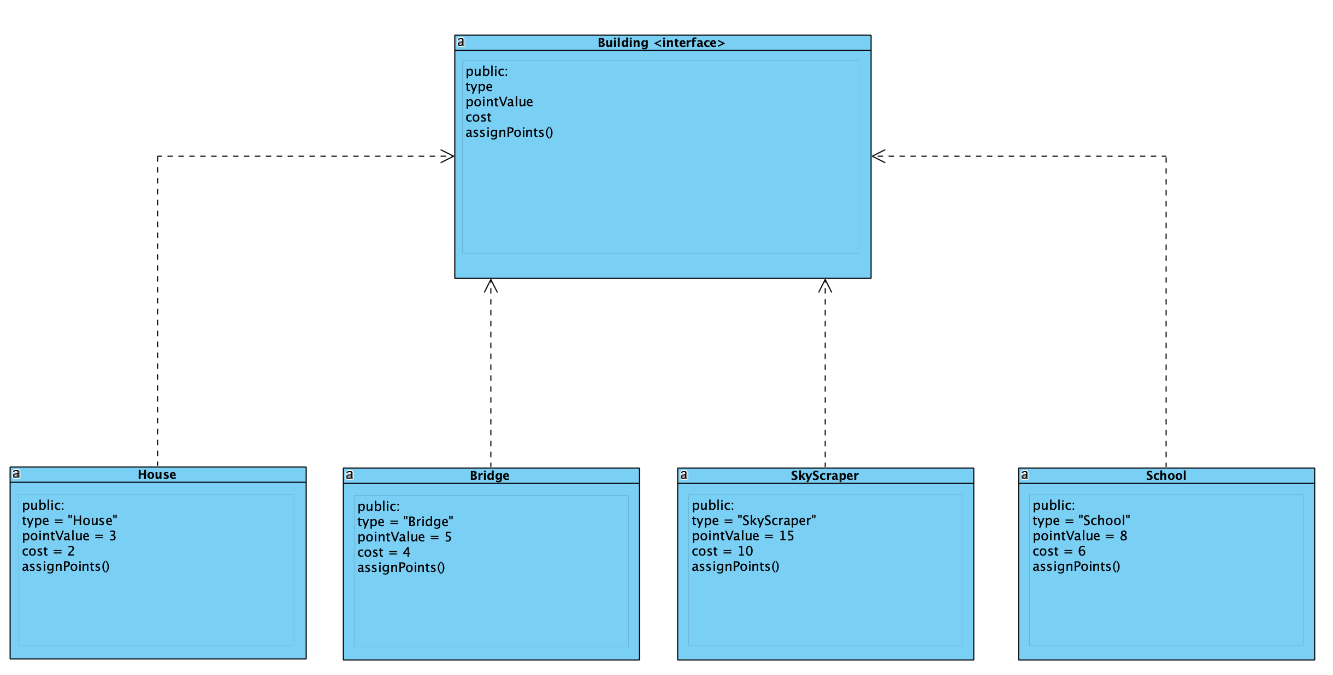
Chart Set 5 – Design Model Interface Realizations
Building interface- realized polymorphicly through the Skyscraper, House, Bridge, and School classes
<Class Hierarchy diagram here>
Building Interface and it’s realizations

Slide 35
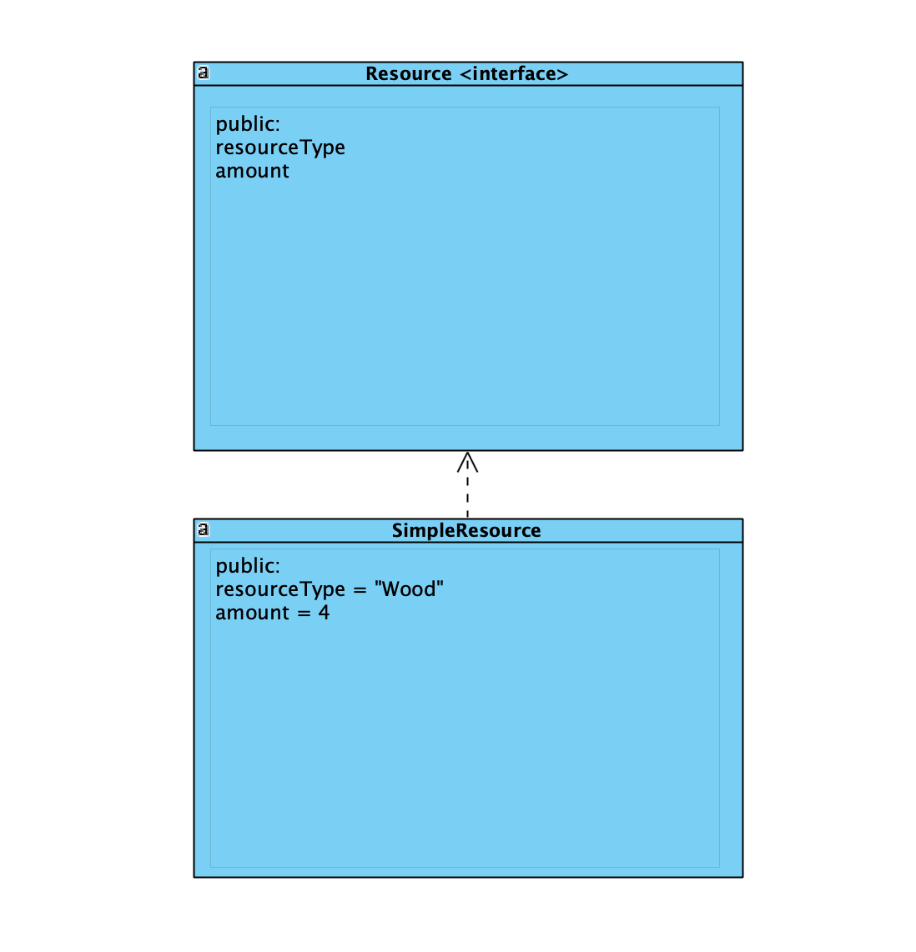
Chart Set 5 – Design Model Interface Realizations
Resource interface- realized through the SimpleResource Class
<Class Hierarchy diagram here>
Resource Interface and it’s realizations

Slide 36
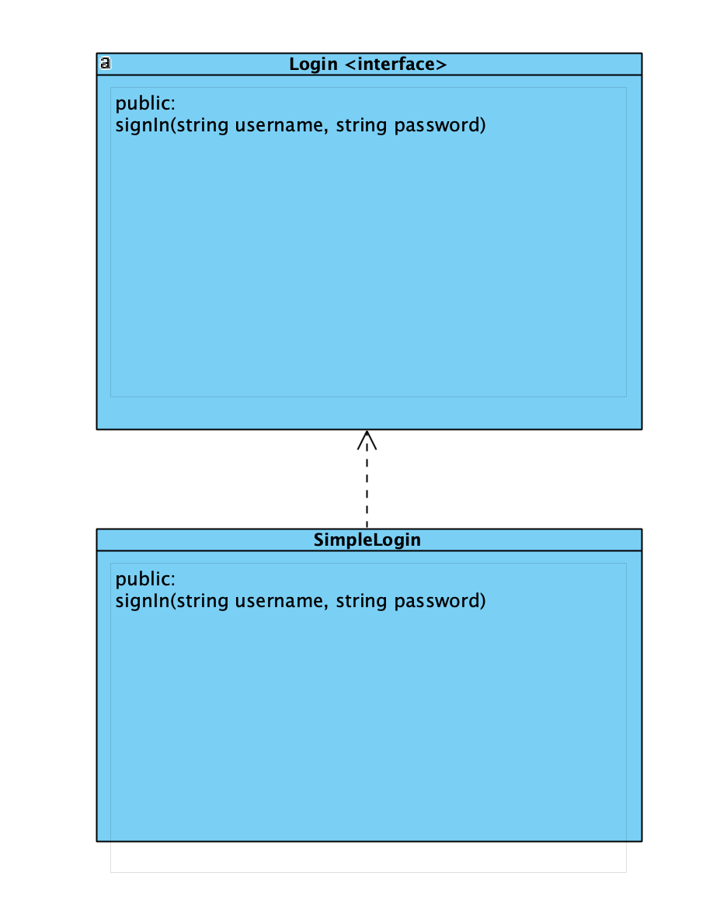
Chart Set 5 – Design Model Interface Realizations
Login Interface- realized through the SimpleLogin Interface
<Class Hierarchy diagram here>
Login Interface and it’s realizations

Slide 37
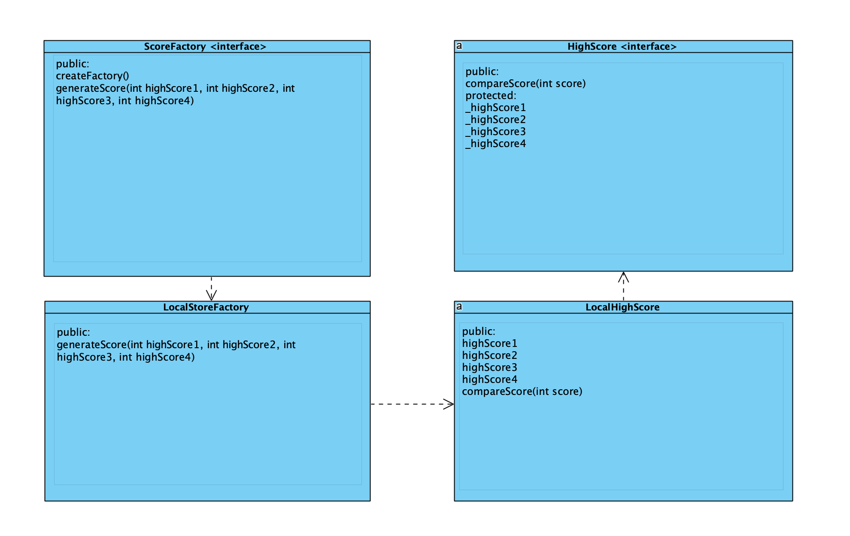
Chart Set 5 – Design Model Interface Realizations
HighScore Interface- The HighScore interface is realized through the LocalHighScore class, that is created using the factory pattern. The factory pattern is done through LocalScoreFactory and ScoreFactory
HighScore Interface and it’s realizations

Slide 38
Chart Set 5 – Design Model Polymorphism GRASP Pattern
A generalization in our system is the builder interface. It is realized through three different classes (SkyScraper, School, and House)
When we add the bridge class as an instance of the builder interface, there is not much change in the system, only one cout line.
<Before Video Here>
<Class Diagram Here>
<After Video Here>
CityBuilder without Bridge
The Building interface and its realizations
CityBuilder with Bridge

Slide 39
Chart Set 5 – Design Model Protected Variations GRASP Pattern
Our interface to an external system is through a High Score interface. This is realized through the LocalHighScore class that is created by the LocalScoreFactory (LocalScoreFactory is created by its factory ScoreFactory).
We can change our high score values to get a different outcome in the system with no change besides the hardcoded values
<Before Video Here>
<Class Diagram Here>
<After Video Here>
CityBuilder with 15 points, 3rd place
The HighScore interface and it’s realizations
CityBuilder with 15 points, 1st place

Slide 40
CHART SET 6 DOCUMENTATION

Slide 41
Chart Set 6 – Documentation
Vision Document - Summary and plan for software development. Provides scheduling, purpose of product, and an overview of how the product will be built.
Supplementary Specification Document- Provides information about how will the product be built. Details attributes of the language used, minimum requirements for the systems to run the software, and any legal issues.
Glossary - A chart highlighting the different names of items, and terminology for the game and what they represent in terms of in game qualities.

Slide 42
Chart Set 6 – Documentation cont. 2
Domain Model - Showcases our Domain Layer diagram that explains how the relationships between the classes interact on dependency.
Design Model - Represents the games’ class and objects and how they interact in a dynamic, and static view.
Brief UC/UC Diagram - Shows the interaction, and use cases represented throughout the software when the player communicates with the game, and the administrator.
Risk List & Risk Management Plan - Graph indicating all the risks, and potential threats to our games classes.

Slide 43
Chart Set 6 – Documentation cont. 3
Fully Dressed Case High Business Value- Provides detailed scenario for our use case “Player builds structure”.
Fully Dressed Case Architecturally Significant- Provides detailed scenario for our use case “Player gathering resource”.
Fully Dressed Case High Risk - Provides detailed scenario for our use case “Player Ends Game”.
Fully Dressed Case Player Forfeits Game - Provides detailed scenario for our use case “Player forfeits game”.

Slide 44
Chart Set 6 – Documentation cont. 4
Software Architecture Documentation - Provides descriptive documentation of the GRASP patterns and the different choices made for each pattern when developing the architecture of our software. Looks back and connects the system sequence diagrams, design models, package diagrams, class diagram, and domain models to our architecture design choices and alternatives. Gives a logical view into our package diagram, and notes the persistence packages implemented into our package diagram layers.

Slide 45
Chart Set 6 – Documentation cont. 5
Implementation Model - Goes through source code explaining how GRASP patterns are implemented in connection to our use cases.
Interface Diagrams - Provides detailed interfaces implemented onto our Domain, and Design model classes/objects, and explains how the packages of our layers interact with these interfaces.
Revision History - A timeline document that tracks revisions, and changes made throughout every phase and inception.

